Slide 1


St. MARTIN’S ENGINEERING COLLEGE
UGC Autonomous
NBA & NAAC A+ ACCREDITED
Dhulapally, Secunderabad – 500 100
Department of
ARTIFICIAL INTELLIGENCE & DATA SCIENCE
Mini Project on
Loan Eligibility Prediction for Banks using Machine Learning
Batch No: 13
1. M. Rajesh (23K81A7296)
2. K. Sree Akhil (23K81A7292)
3. CH. Ram Mahideep Varma (23K81A7279)
Under the Guidance of
Mr. V. Vishnu Vardhan
Assistant Professor
Department of Artificial Intelligence & Data Science

Slide 2
OUTLINE
Abstract.
Detailed Design.
Contribution of the Candidate.
Results Obtained.
References.
80% of Code Implementation.

Slide 3
ABSTRACT
The demand for loans has increased significantly for both personal and business purposes. Due to limited assets, banks cannot grant loans to every applicant. And the Loan approval processes in banks often depend on manual process, which leads to delays, biases, and high default risks. So, In this project we introduces a machine learning - based system to predict loan eligibility accurately and efficiently and within less time. Using a datasets including features like income, credit history, employment status, loan amount, and tenure. In this we applied supervised learning algorithms including Logistic Regression, Decision Trees, Random Forest, and Support Vector Machines. Data preprocessing involves in handling missing values, encoding categorical variables.

Slide 4
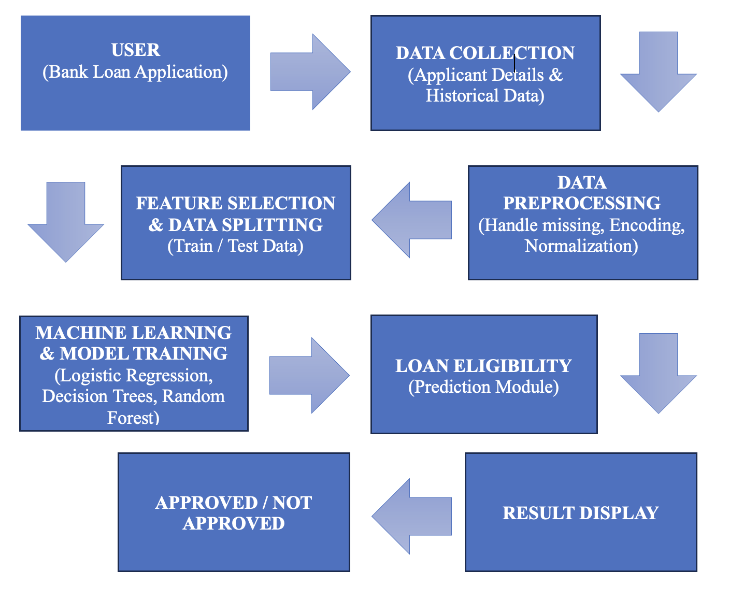
DETAILED DESIGN

Slide 5
CONTRIBUTION OF THE CANDIDATE
1. K. SREE AKHIL CONTRIBUTION TOWARDS: Idea and Problem Selection, System design (Architecture, ER Diagram, Flowcharts) and Documentation / Presentation.
2. M. RAJESH CONTRIBUTION TOWARDS: Coding (Frontend / Backend / ML Model), Testing and Debugging and Result Analysis.
3. CH. RAM MAHIDEEP VARMA CONTRIBUTION TOWARDS: Literature Survey and Research, Proposed System and Existing System and Algorithms / Techniques.

Slide 6
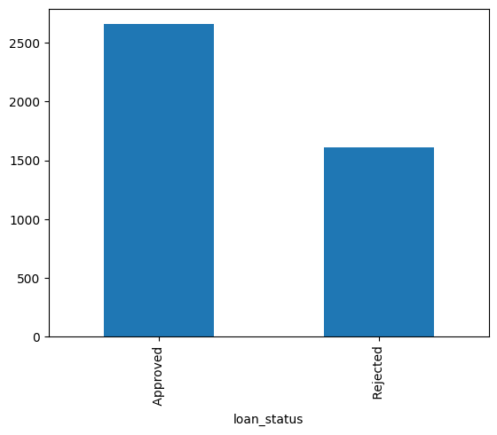
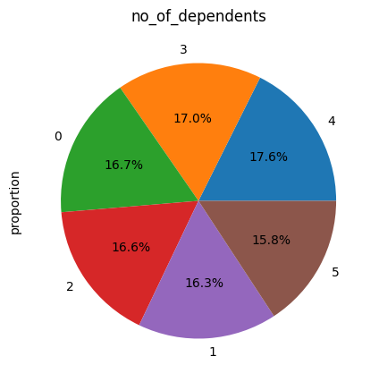
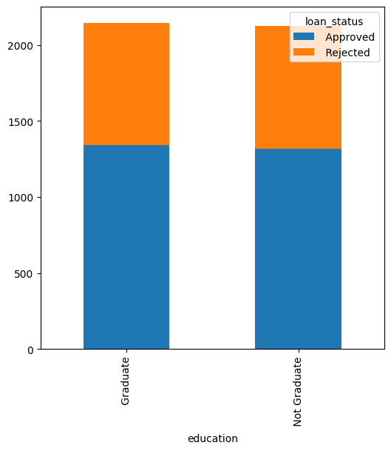
RESULTS OBTAINED
LOAN STATUS
(Bar Graph)
COMPARISON OF DEPENDENTS
(Pie Chart)
COMPARISION IN EDUCATION
(Stacked Bar Chart)

Slide 7
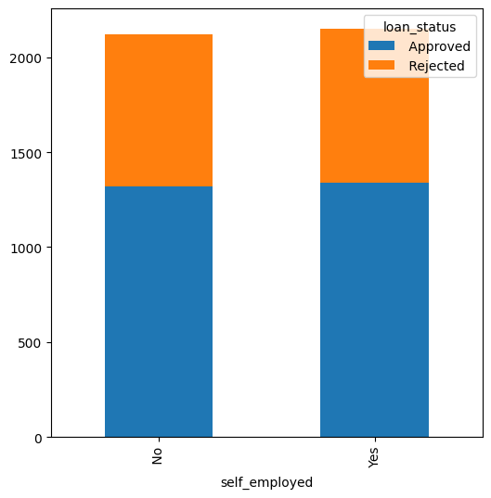
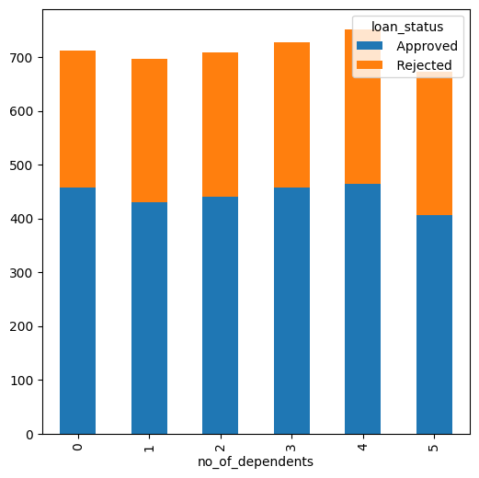
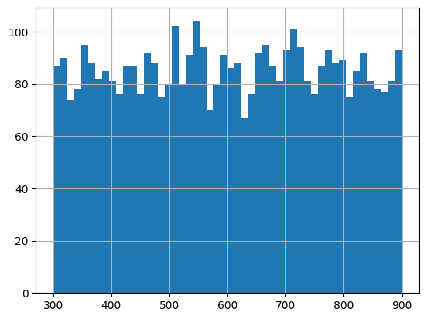
COMPARISION IN SELF EMPLOYED
(Stacked Bar Chart)
NO. OF DEPENDENTS
(Stacked Bar Chart)
DISTRIBUTION OF THE VARIABLES
(Histogram)

Slide 8
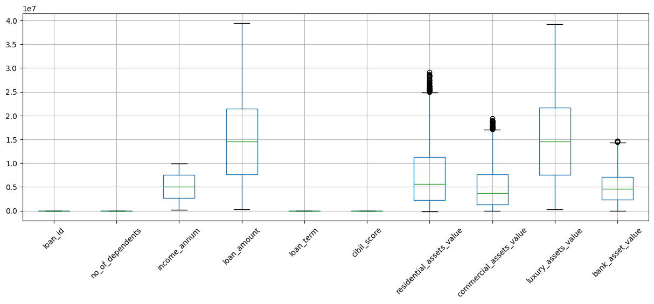
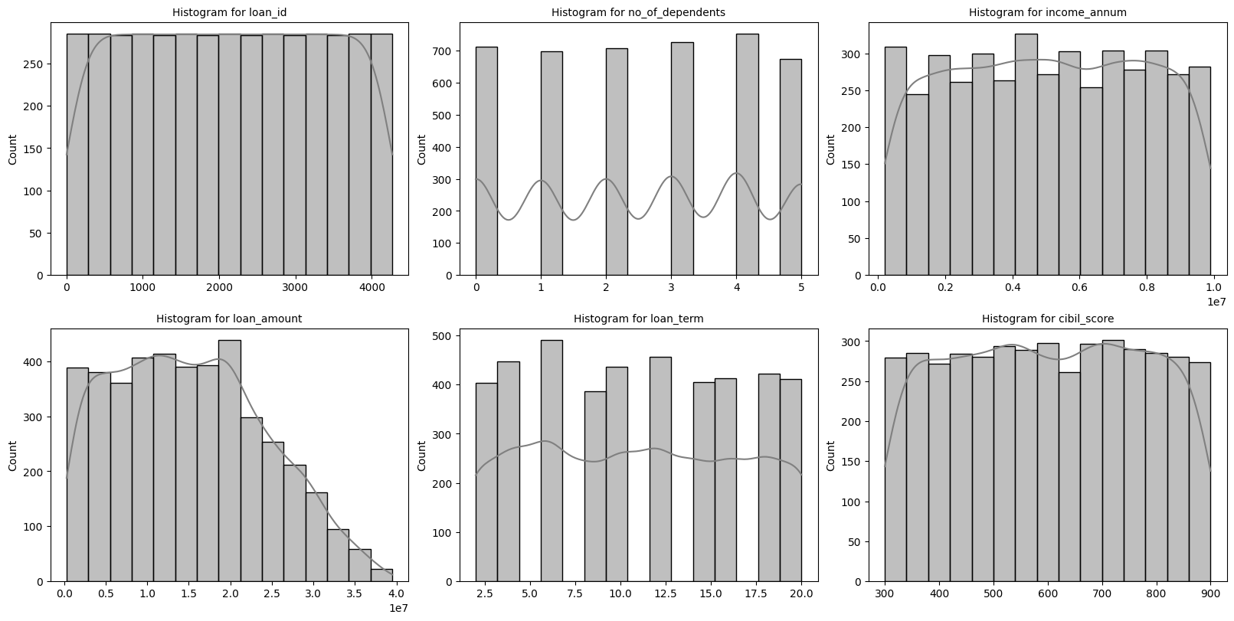
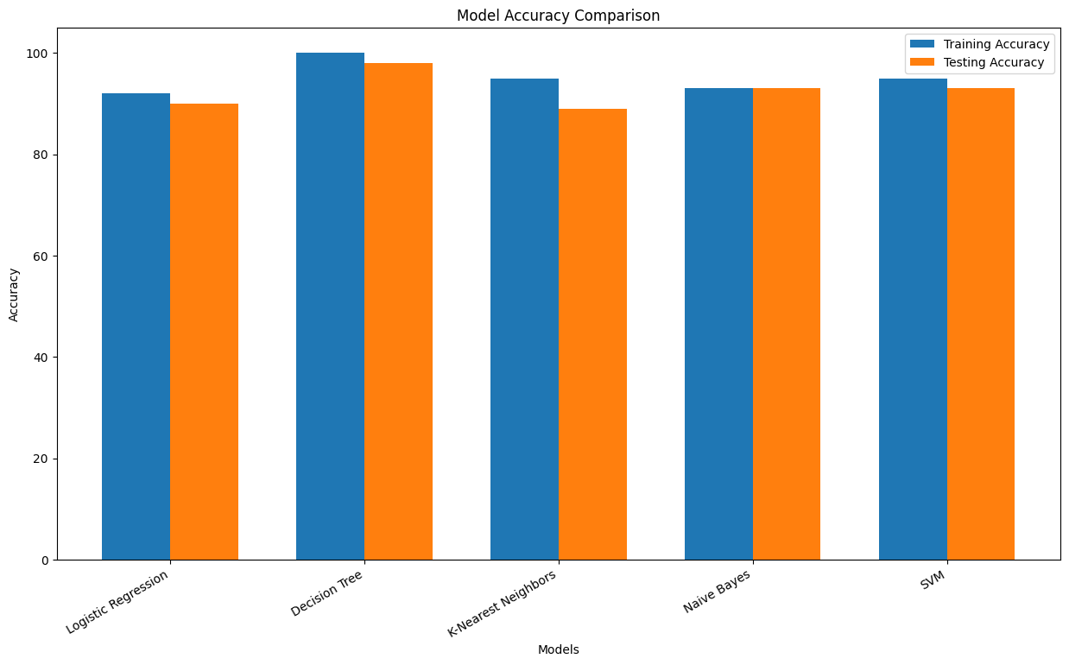
CHECKING OUTLIERS FOR NUMERICAL COLUMNS
(Box Plot)
REPRESENTATION OF ALL DATA SETS
(Histogram)
COMPARISON OF ALL MODELS
(Grouped Bar Chart)

Slide 9
REFERENCES
Reserve Bank of India - Credit Risk Management Guidelines:- https://www.rbi.org.in
Kaggle - Loan Prediction Dataset:- https://www.kaggle.com
Scikit-learn - Documentation:- https://scikit-learn.org
Tom M. Mitchell - Machine Learning - McGraw-Hill:- 1997 (Education Company)
Loan Eligibility Prediction Using Machine Learning - Sanketika Vidya Parishad Engineering College:- 23rd July, 2025

Slide 10
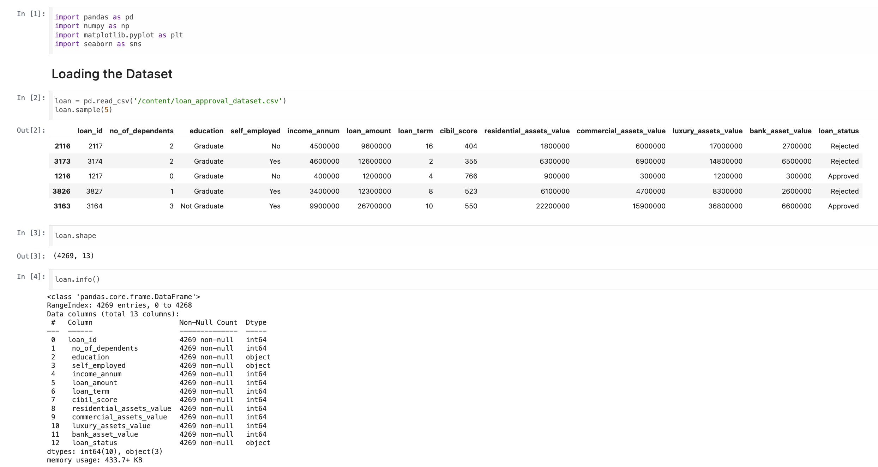
80% of Code Implementation

Slide 11
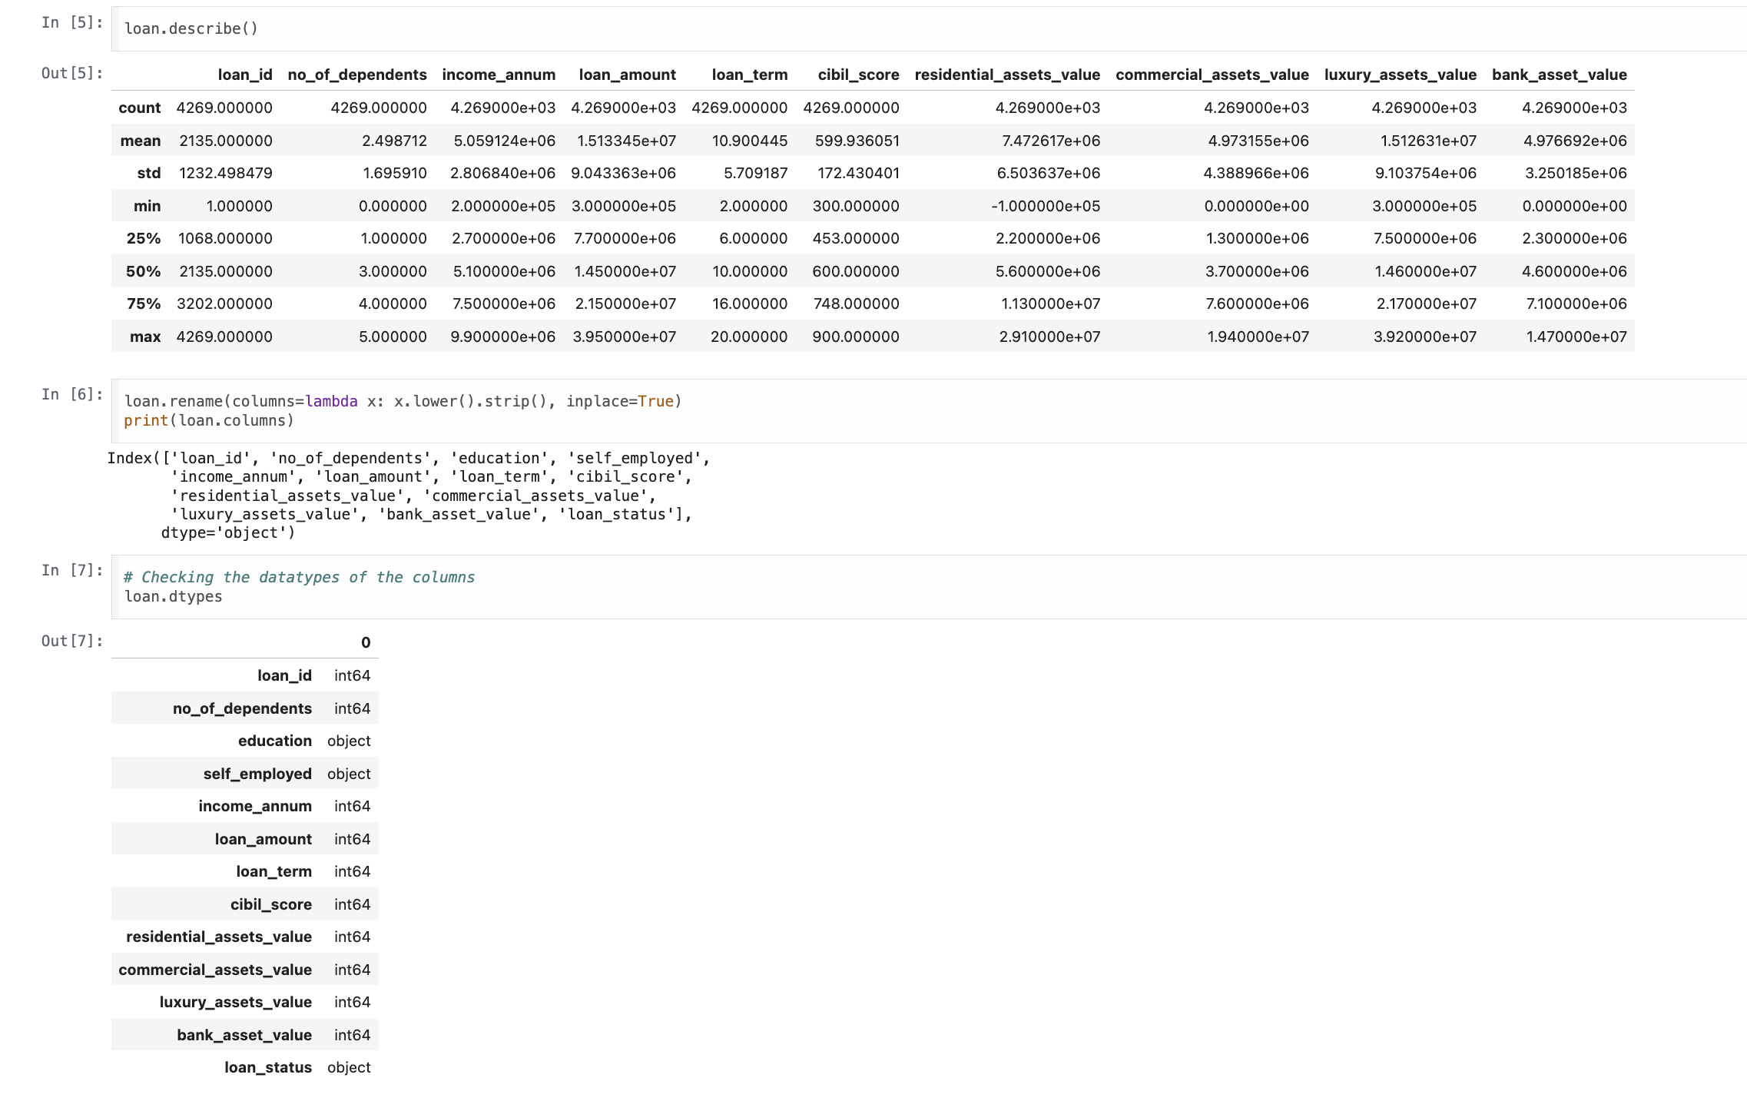

Slide 12
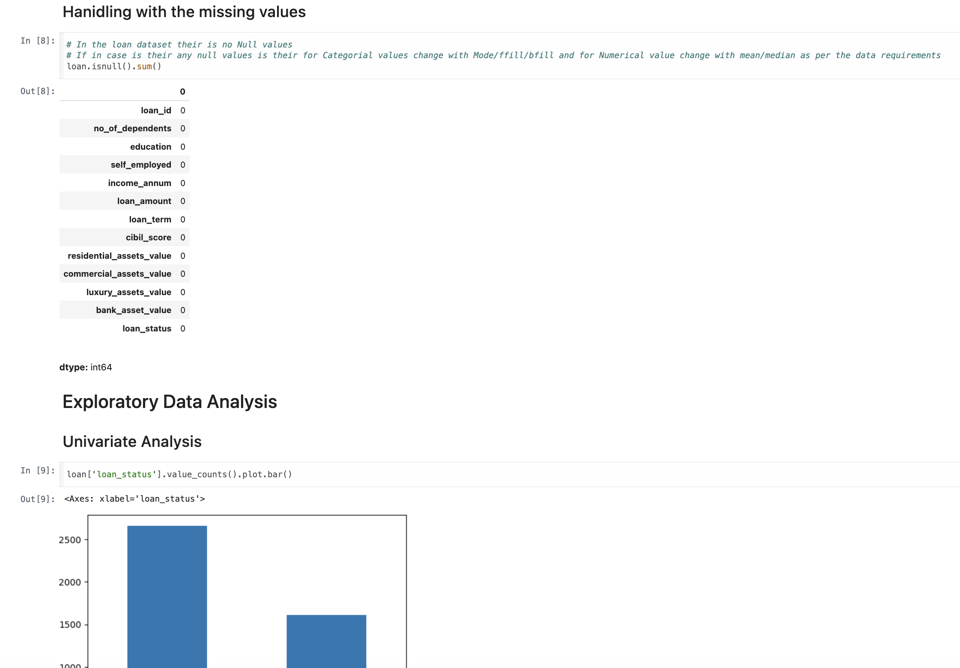

Slide 13
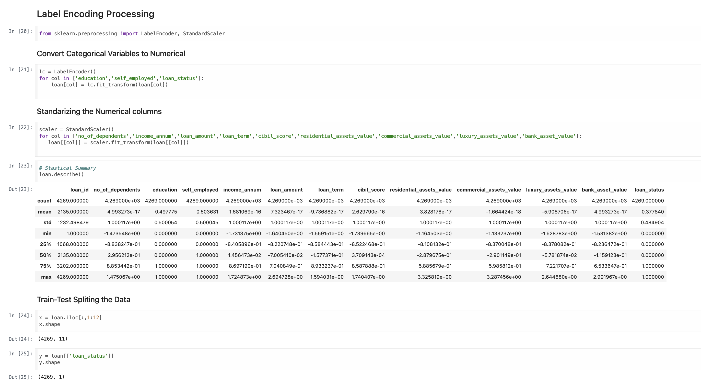

Slide 14
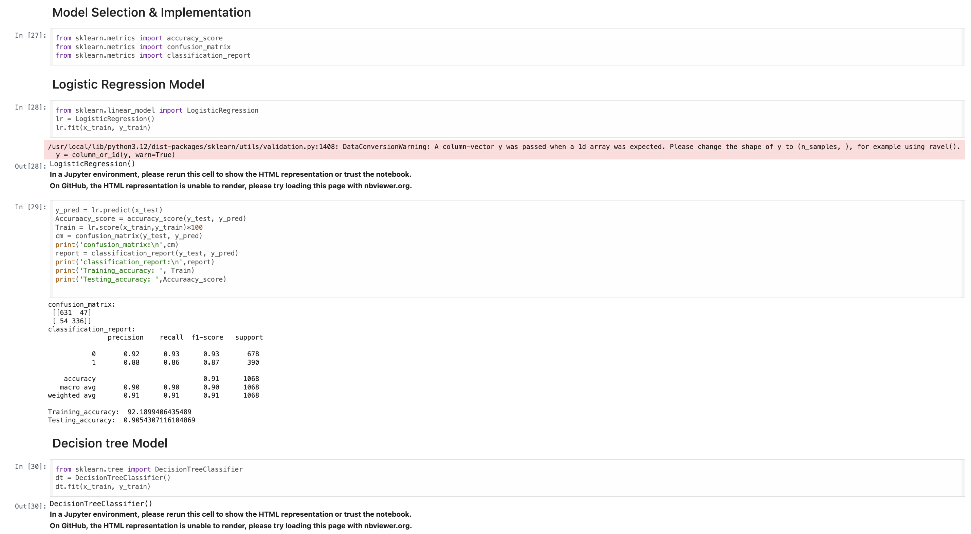

Slide 15
QUERIES ??

Slide 16
THANK YOU

